Slide 1


HOTEL BOOKING WEBSITE PROJECT
Develop By – Sohel Shaikh

Slide 2

Content
Objectives
Software Requirement
Admin Module
User Module
Login Result
Future Enhancement
Conclusion

Slide 3
Objectives
To Manage The Details Of Hotel , Rooms , Services , Customers , Payments
To Help Search Any Information Easily
Easy Maintenance And Updating Of Data
To Save Time And Effort

Slide 4
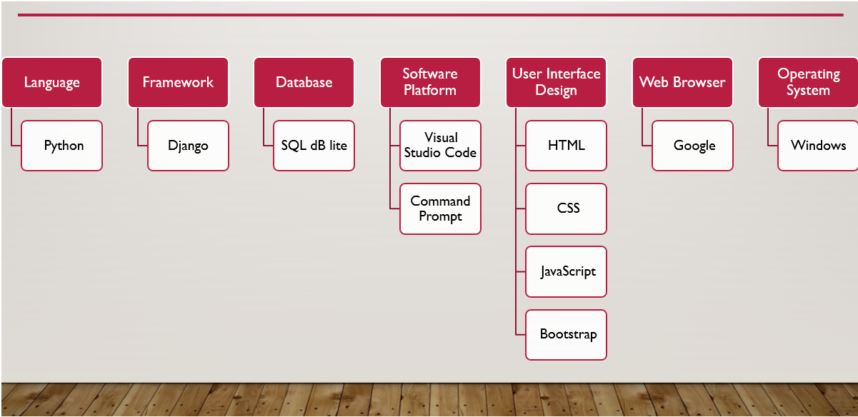
Software Requirements

Slide 5
Admin Module
Manage Hotel Details ( Add / Edit / Delete)
View Hotels Details
View Totals Bookings
Admin Can the Details Of Registered Users
Admin Can Also Update The Page Content
Admin Add A Hotel Category Filters
Logout

Slide 6
User Module
View All Hotels Details
Search And Filter
Hotel Booking
View Booking Details
View Profile
Update His / Her profile
Logout

Slide 7
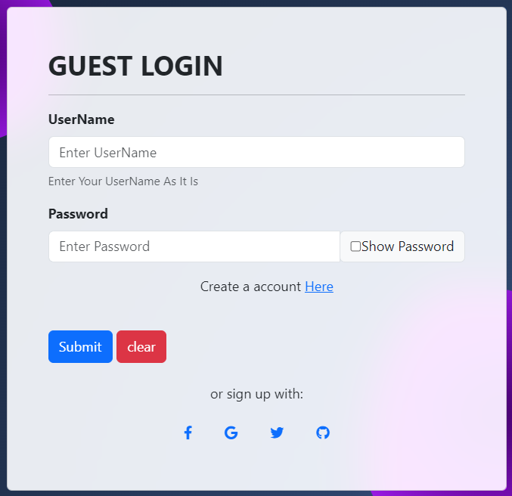
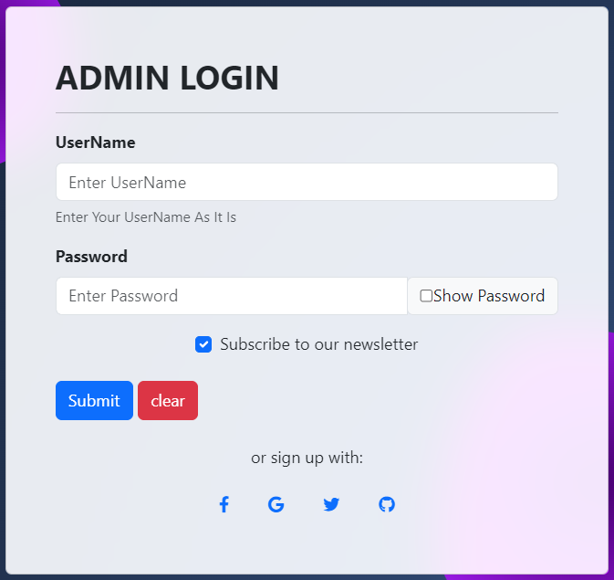
Login Page

Slide 8
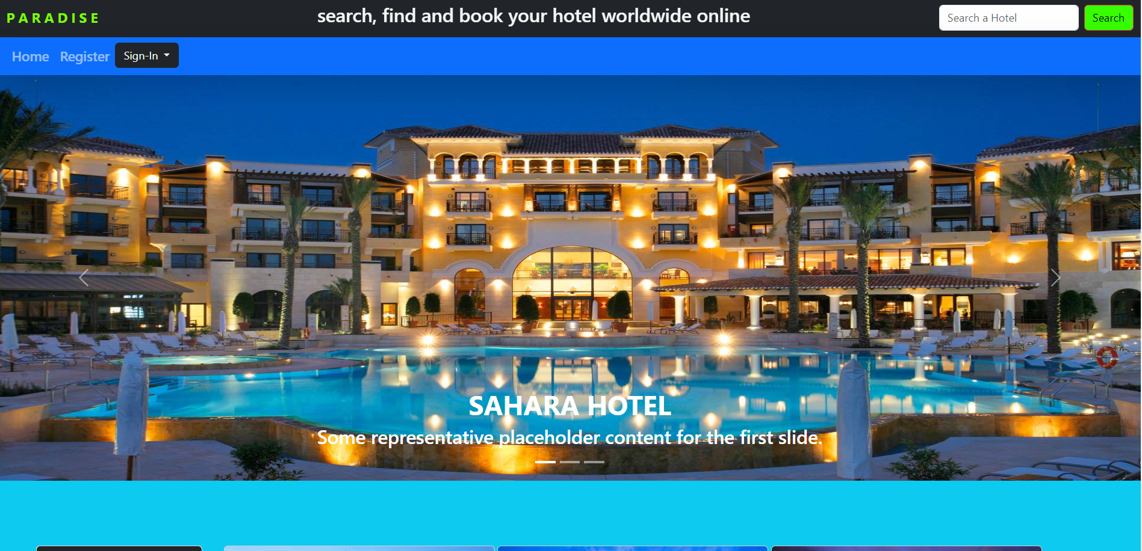
Home Page

Slide 9
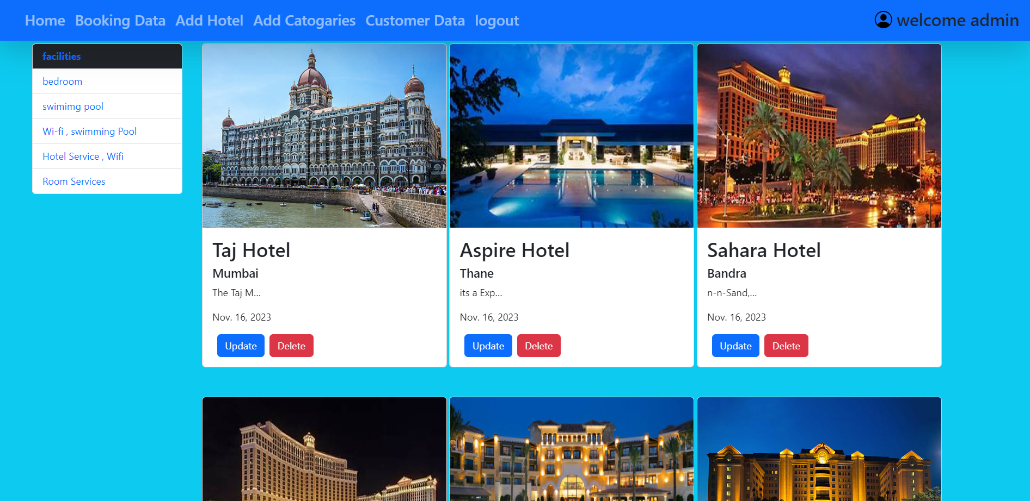
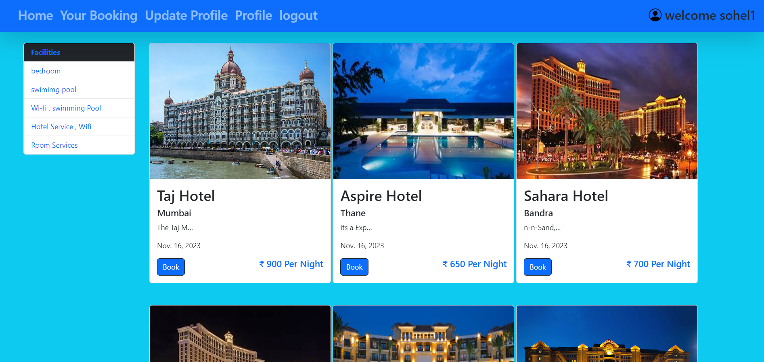
Home Page
Admin Home Page
User Home Page

Slide 10
Future Enhancement
We Can Give More Advanced Software For Hotel Booking System Including More Facilities
System Security , Data Security And Reliability Are The Striking Features
it Provides A Friendly Graphical User Interface Which Proves To Be Better When Compared To The Existing System

Slide 11
Conclusion
This Software Provides An Easy – To – Easy User Interface To Allow For Simple Access To Book Requests And Customer Information
Main Aim is Provide A Very User Friendly Customer Registration System Who Want To Take Hotel Rooms For Book

Slide 12
THANK YOU

